Slide 1
Consumer Credit Risk — PD Segmentation & Policy Impact
How borrower risk, loan structure, and approval thresholds drive defaults, losses, and risk-adjusted revenue
Python · SQL · Power BI | Lending Club Consumer Loans

Slide 2
Business Context
Why This Analysis Matters
Consumer lending portfolios contain borrowers with widely varying risk profiles.
Uncontrolled approvals lead to:
Elevated defaults
Concentrated losses
Revenue erosion from credit losses
Current portfolio facts:
404K loans
19.97% default rate
$1.25bn total expected loss
$3.05bn expected net revenue
Problem: How do we reduce loss and protect revenue without shutting down growth?

Slide 3
Core Business Questions
?
Can borrowers be reliably rank-ordered by default risk?
Where is expected loss concentrated across borrower segments?
How does a PD-based approval policy change portfolio risk, loss, and revenue?

Slide 4
DATA AND METHODOLOGY(High Level)
Dataset: Consumer installment loans (≈ 404K observations)
Target: Default (Charged-Off / Default = 1)
Methodology:
Logistic Regression with WOE encoding
PD segmentation into deciles
Outputs:
Probability of Default (PD)
Expected Loss (EL)
Expected Net Revenue
Validation focus:
Rank-ordering
Stability
Interpretability

Slide 5
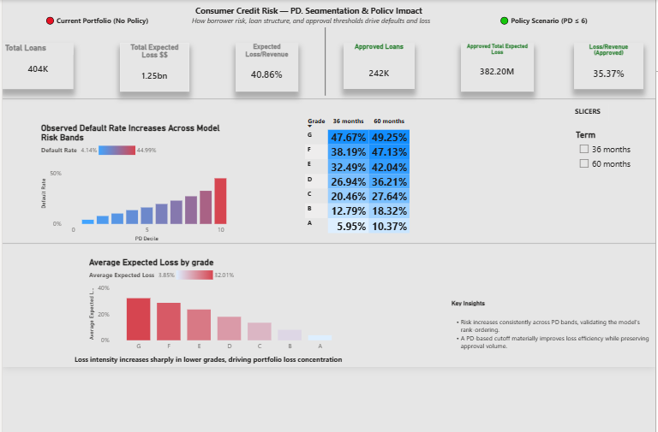
Consumer Credit Risk – PD Segmentation & Policy Impact

Slide 6
Evidence: PD Decile Performance
Default rates rise monotonically from:
~4% (lowest PD decile) to ~45% (highest PD decile)
Strong separation across risk bands
KS ≈ 30
Answer to Q1:
Yes. The model consistently ranks borrowers from safer to riskier, with default rates increasing sharply across risk groups. This provides a reliable basis for approval and policy decisions
ANSWERING Q1: MODEL RISK RANKING
Can borrowers be reliably rank-ordered by default risk?

Slide 7
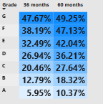
ANSWERING Q2: RISK CONCENTRATION (GRADE × TERM)
Key facts:
Default risk increases from Grade A → Grade G
60-month loans consistently default more than 36-month loans
Highest-risk segment:
  Grade G, 60 months ≈ 49% default rate
Answer to Q2 (Part 1):
✔ Risk is concentrated, not evenly distributed — driven by lower grades and longer tenors.
Where is expected loss concentrated across borrower segments?

Slide 8
Average Expected Loss by Grade
Expected loss increases sharply from Grade A → G
Lower grades contribute disproportionately higher loss per loan
Answer to Q2 (Part 2):
✔ Loss is driven by risk layering — weak borrower quality combined with longer exposure duration.
ANSWERING Q2: EXPECTED LOSS CONCENTRATION
Which segments drive expected loss?

Slide 9
BASELINE: CURRENT STATE (BEFORE POLICY)
Applicant Portfolio — Current State
Facts:
Loans: 404K
Default Rate: 19.97%
Avg Expected Loss: 11.97%
Total Expected Loss: $1.25bn
Expected Net Revenue: $3.05bn
Interpretation:
The unrestricted portfolio carries material embedded risk that erodes revenue.
.

Slide 10
PROPOSED APPROVAL POLICY
PD-Based Approval Rule
Approve borrowers up to PD cutoff
Exclude highest-risk PD deciles
Objective:
  Reduce expected loss
  Preserve meaningful approval volume
  Improve risk-adjusted outcomes
This policy is evaluated against the full applicant pool.

Slide 11
POLICY OUTCOME (AFTER IMPLEMENTATION)
Approved Portfolio — Policy Outcome
Facts:
Approved Loans: 242K
Approval Rate: 60.0%
Approved Default Rate: 11.96%
Avg Expected Loss: 7.14%
Total Expected Loss: $382M
Expected Net Revenue: $1.08bn
.

Slide 12
ANSWERING Q3: BEFORE vs AFTER IMPACT
How does a PD-based approval policy change portfolio risk, loss, and revenue?
Portfolio Performance Comparison
Metric | Before | After
Loans | 404K | 242K
Default Rate | 19.97% | 11.96%
Avg Expected Loss | 11.97% | 7.14%
Total Expected Loss | $1.25bn | $382M
Expected Net Revenue | $3.05bn | $1.08bn

Slide 13
NEW INSIGHT: LOSS / REVENUE
Risk-Adjusted Profitability
Loss / Revenue Ratio
Current State: 41%
After PD Policy: 35%
Interpretation:
For every $1 of revenue:
  $0.41 is lost to credit risk before policy
  $0.35 after policy
Answer to Q3 (Economics):
✔ The policy improves revenue quality, not just risk metrics.

Slide 14
FINAL INTERPRETATION
What This Means
PD modeling enables reliable borrower ranking
Risk and loss are highly concentrated
PD-based approval:
  Reduces expected loss by ~70%
  Improves loss-to-revenue efficiency by 6 percentage points
  Maintains 60% approval rate
This is a risk-adjusted optimization, not volume maximization.

Slide 15
Key Assumptions & Limitations
Expected Loss estimated as PD × Loan Amount (LGD ≈ 100%, EAD ≈ exposure)
Expected revenue approximated using contractual interest rate and loan term
Analysis assumes static borrower behavior under the approval policy
Results reflect expected, not realized, outcomes
Pricing optimization and recovery dynamics are out of scope
Relative risk ranking and policy impact conclusions are directionally robust

Slide 16
CONCLUSION & RECOMMENDATION
Conclusion
The PD model is fit for decisioning
Credit risk is structural, not random
Approval policy materially improves:
  Portfolio stability
  Loss containment
  Revenue efficiency
Recommendation
Adopt PD-based approval thresholds and monitor performance continuously using this framework.

